Slide 1

Customer Revenue Prediction using Google Analytics Data
Barathwaaj Parthasarathy, Pravin Sundar, Prashanth Thirukkurungudi Sekar

Slide 2
Business Background
Google Analytics, a free tool that helps analyze website traffic used by most companies to monitor digital traffic
GA provides a holistic view of the effectiveness of all the campaigns that are run by companies to track digital marketing effectiveness

Slide 3
Methodology
Data Acquisition
Exploratory Data Analysis
Baseline Models
Feature Engineering
Model Building
Insights and Analysis

Slide 4
Data Snapshot
Transaction level data of E-Commerce domain from Google store
903,653 Transactions
55 Features
12 Numerical
43 Categorical
Missing Values 12 features have more than 50%
Data includes transactions for one year(08/16-08/17)
Notes:
The extracted data is a transaction level data of Google Analytics belonging to the E-Commerce Domain. The data contains 903653 transactions and 55 Features.Out of these 55 features, 12 are numerical and 43 are categorical(including binary).

Slide 5
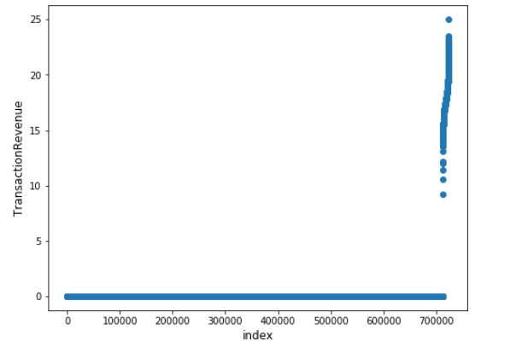
Exploratory Data Analysis
Imbalance in the data with 98.6 % of records belonging to a single class
Missing values treated
18 single level features dropped
Synthetic Minority Oversampling Technique performed during the feature engineering phase to overcome the issue of imbalance

Slide 6
Selected Business Questions
Who is profitable ?
How much revenue ?
What is their lifetime value ?
Re-marketing / Re-targeting

Slide 7
Techniques Employed
Customer Identification
Logistic Regression
Random Forest Classifier
Revenue Prediction
Linear Regression
Random Forest Regressor
Customer Lifetime Value
Betageofitter (BG/NBD)
GammaFitter
Gradient Boosting Classifier
Gradient Boosting Regressor

Slide 8
Baseline Models and Feature Engineering
Levels of features reduced
New features by combining existing ones
Selecting features based on business understanding
Model | AUC | Recall
Logistic Regression | 0.964 | 0.126
Random Forest | 0.911 | 0.361
Gradient Boosting | 0.986 | 0.303

Slide 9
Identifying Revenue Generating Customers
Data grouped by customer ID
Created revenue generating flag
Data balancing using SMOTE
Model | Recall
Logistic Regression | 0.839
Random Forest Classifier | 0.885
Gradient Boosting Classifier | 0.834
The best model captured 88.5% of customers who are actually revenue generating. This resulted in a loss of approximately 7% of the total revenue

Slide 10
Customer Revenue Prediction
Transaction level data used for training
Timestamp used to capture trend and seasonality
Results of classification model added as independent variable
Model | RMSE
Linear Regression | 1.804
Random Forest Regressor | 1.647
Gradient Boosting Regressor | 1.625
The best model predicted a total revenue of 2.7 billion dollars generated over the analysis period

Slide 11
Customer Lifetime Value Prediction
Betageofitter (BG/NBD) model considering the frequency and recency of the customers
Evaluated Betageofitter model using a holdout dataset with last 3 months of transactions
Gammafitter model which takes into account the frequency and monetary value of the customers

Slide 12
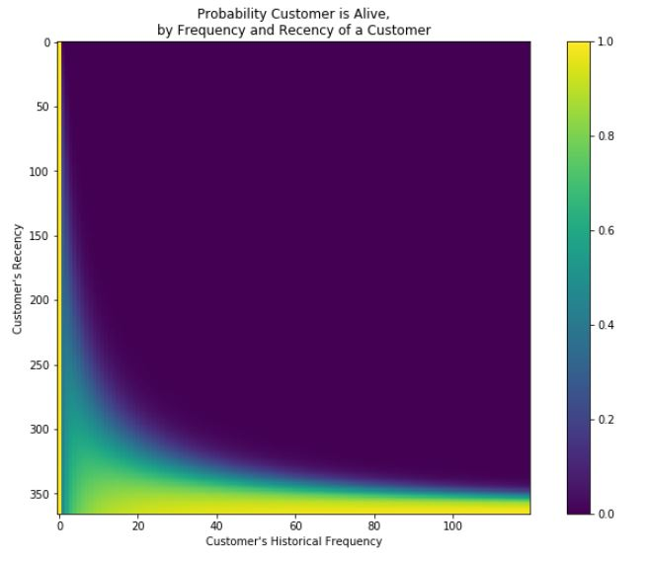
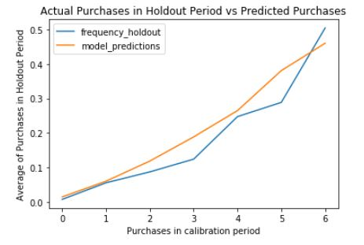
A customer who has purchased a lot and most recently is our most important/profitable customer
A customer who has purchased a lot but not recently have probably stopped purchasing (or) churned
A customer who has a frequency of 120 and recency value of 350 is the most profitable customer
Plot groups all customers in the training period by frequency and then averages over their frequency in the hold out period
It can be observed that the model predicts pretty accurately for purchases ranging from 0 to 5 but over-estimates for 3 and 5 purchases

Slide 13
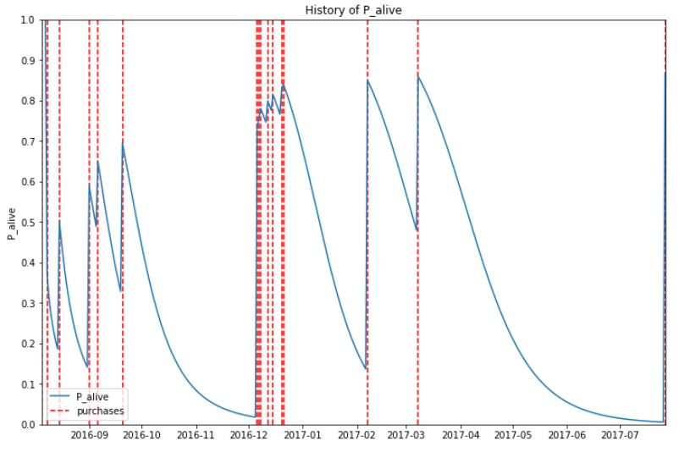
Plot shows purchase pattern and the probability of the customer being alive
Even though this customer is not a frequent visitor, the customer brings in substantial value to the business and the predicted value of the customer for the next 12 months is 16 million

Slide 14
Insights and Analysis
From this project the top prospective customers based on their revenue generating potential, their revenue sum and the total value they own to the business are identified
This monetary based ranking analysis (Customer Lifetime Value) enables the business to optimize their re-targeting and re-marketing strategies and eventually improve their Return on Investment (ROI)

Slide 15
Challenges and Improvements
Transactions only for a year, failed to capture month-wise seasonality trends
Cost Sensitive Learning and Cluster Sampling to overcome curse of imbalance
More sophisticated models along with stacking could be employed

